Slide 1

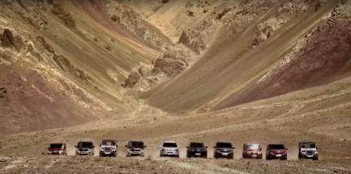
Capstone Project
Mahindra First Choice Services (MFCS)
Harsh Parikh
Rahul Waghela
Nilesh K. Varma

Slide 2
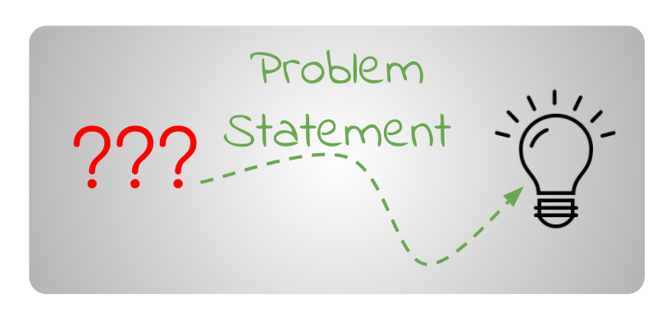
Identifying the ownership pattern of cars
Identifying the spending pattern of customers
Expected business outcome

Slide 3
Business Need & Requirement
Client:
Mahindra First Choice Services (MFCS)- A Mahindra Group Co.
Aim:
MFCS aim to open 400 workshops pan India until march 2018.
Improve business and hence growth by use of existing data from Aril 2012 to October 2016.

Slide 4
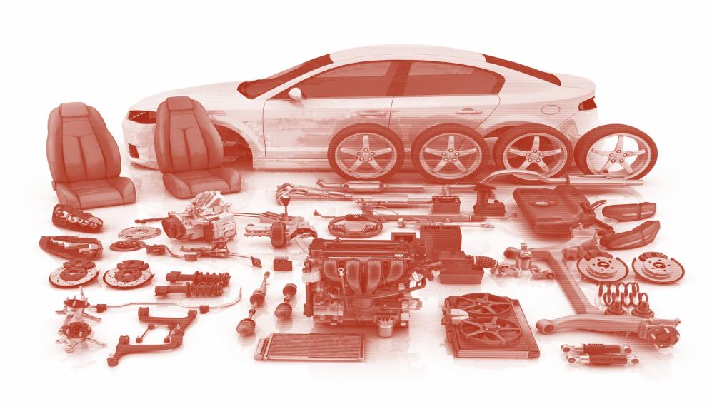
Product & Domain knowledge
EDA

Slide 5
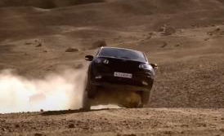
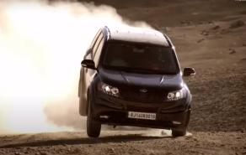
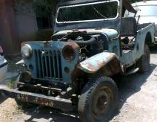
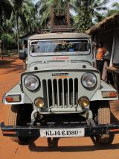
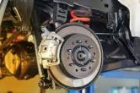
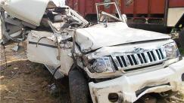
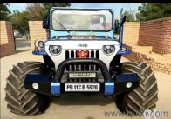
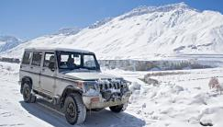
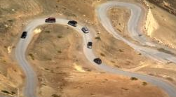
Understanding Domain (Automobile Tech.)
Mishandling of Vehicle/s
Vehicle Age
Regular Maintenance
Overhauling
Wear & Tear
Accidents
Upgrades
Breakdown/s due to Harsh environments

Slide 6
Understanding data
Data:
Revenue
Vehicle downtime (Invoice + Job card)
Vehicle running kms
Customer location and Plant Location
Customer type and Vehicle ownership details
Vehicle make and model (Details)
Geographical preference of vehicles
Cost breakdown (Parts & Services)

Slide 7
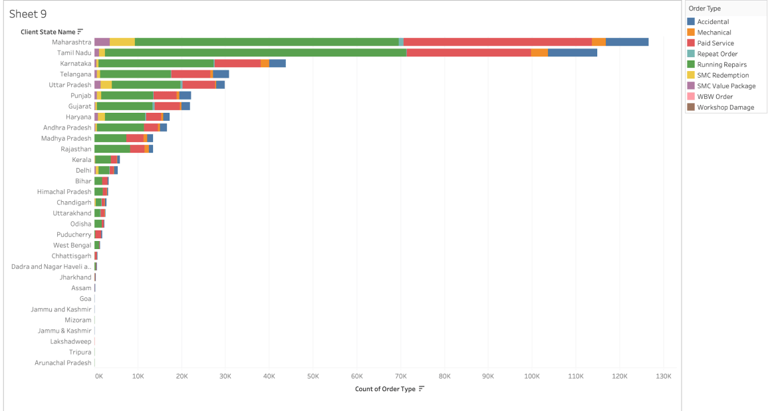
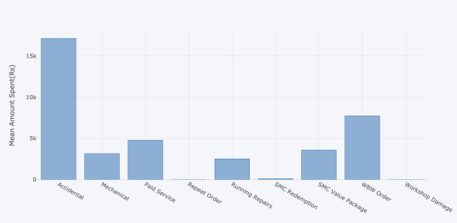
Understanding Services

Slide 8
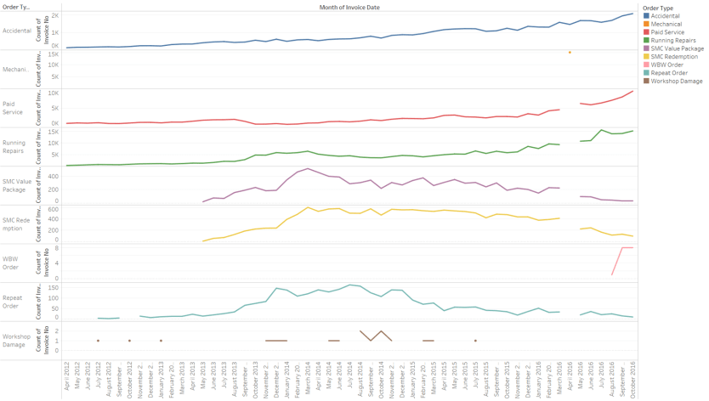
Understanding Services Trend

Slide 9
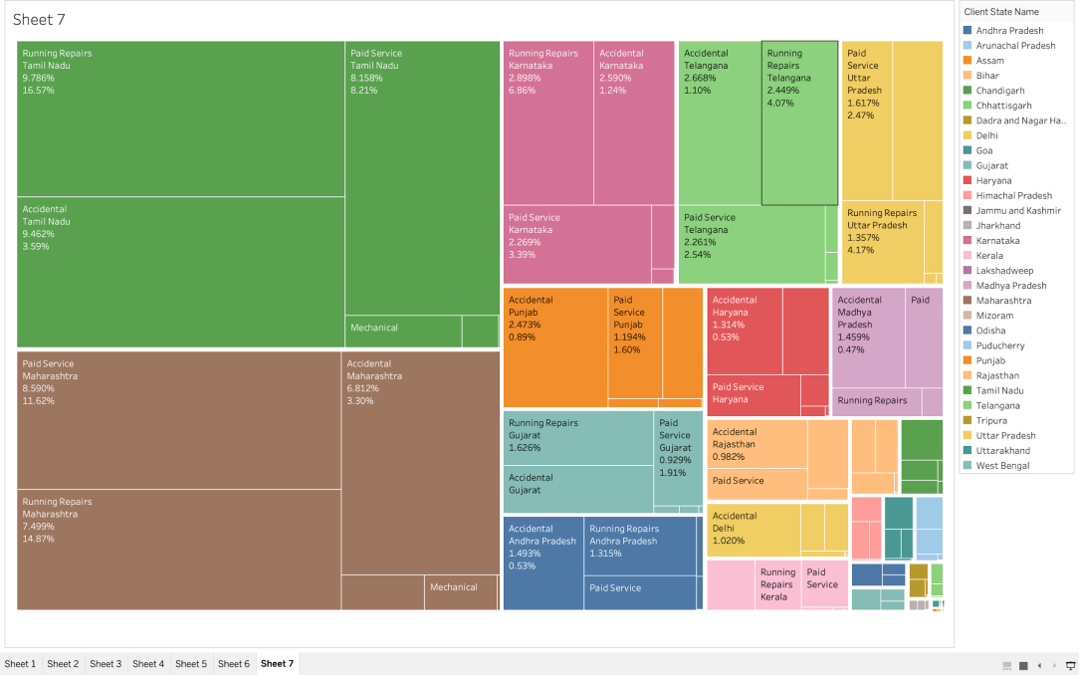
Services(Revenue)

Slide 10
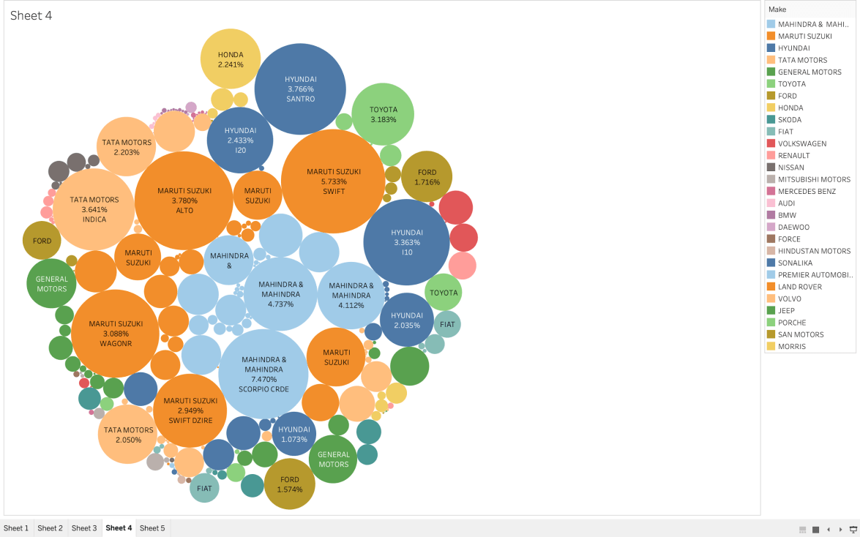
Vehicle Make & Model Distribution
%- Revenue
Size-Model count
Major Running models:
Mahindra Scorpio
Maruti Suzuki-Swift
Mahindra Bolero
Mahindra Xylo
Maruti Suzuki-Alto
Hyundai-Santro
Tata Indica
Toyota Innova
Hyundai-i10
Maruti Suzuki-Wagonr
Maruti Suzuki-Dzire

Slide 11
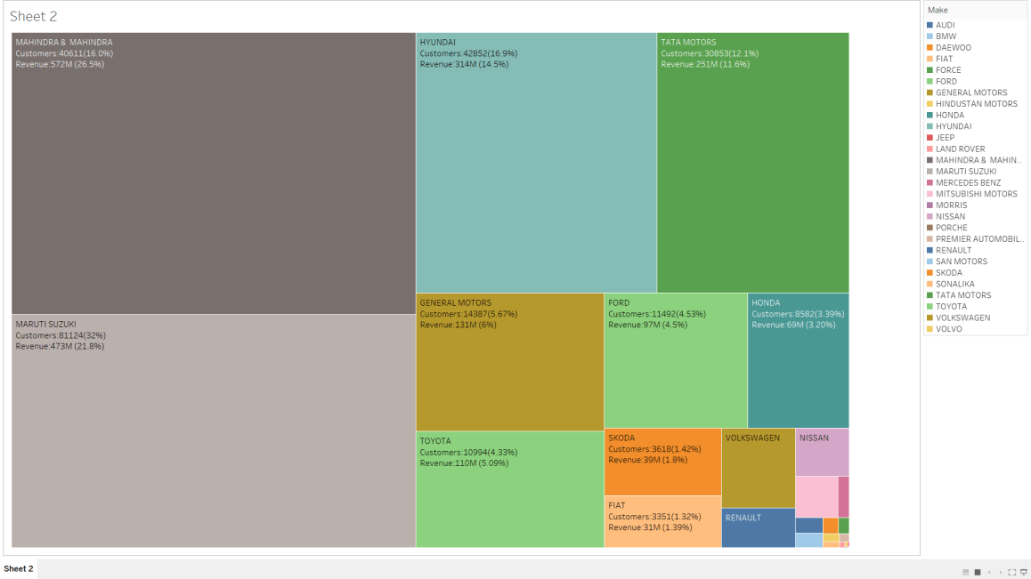
EDA:Tree map (Revenue & Customers)

Slide 12
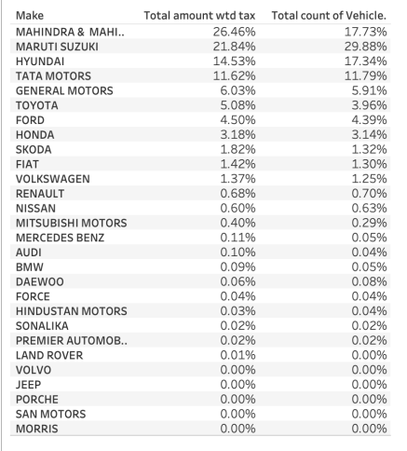
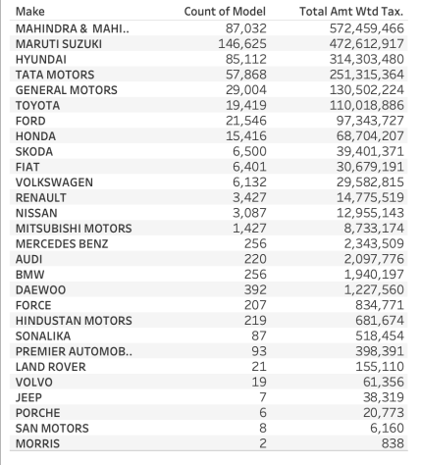
EDA: Revenue Vs Model

Slide 13
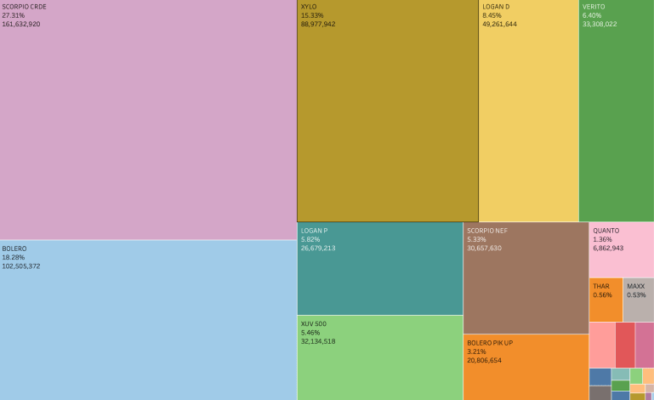
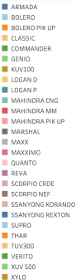
EDA:Mahindra(Revenue Vs Make)
% of TR : 26.46 %
Revenue: ~57.24 Cr
% of CV : 17.73%
Vehicles: 87032

Slide 14
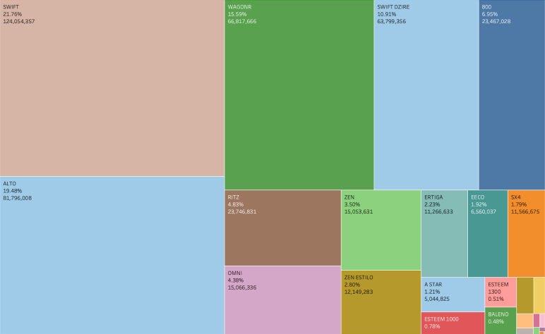
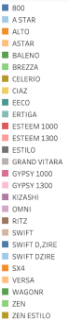
EDA:Maruti(Revenue Vs Make)
% of TR : 21.84 %
Revenue: ~47.26 Cr
% of CV : 29.88%
Vehicles: 146625

Slide 15

Business Perspective

Slide 16
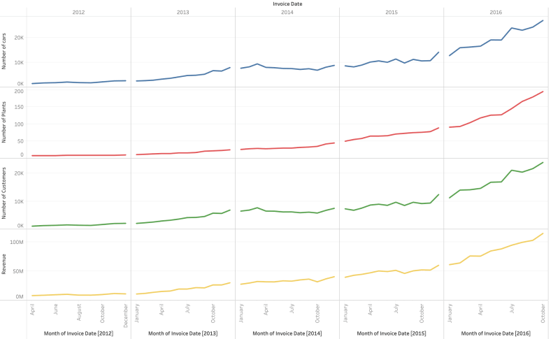
EDA: Growth Rate(Revenue, Cust. No., Plant No.)
Data looks positively correlated
It should be verified by growth rate of each feature

Slide 17
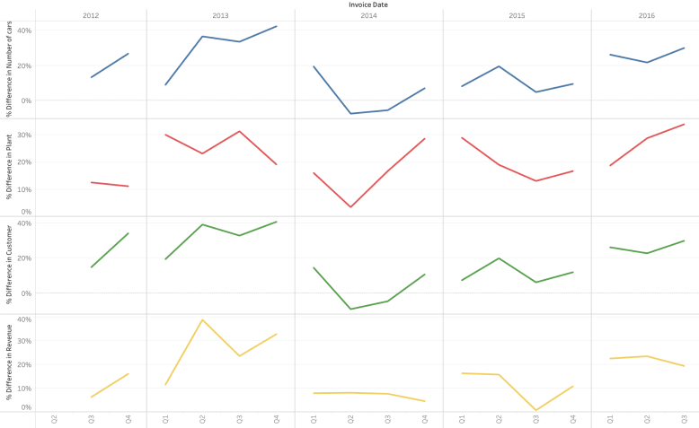
EDA:Growth rate Q2Q(Revenue, Cust. No., Plant No.)

Slide 18
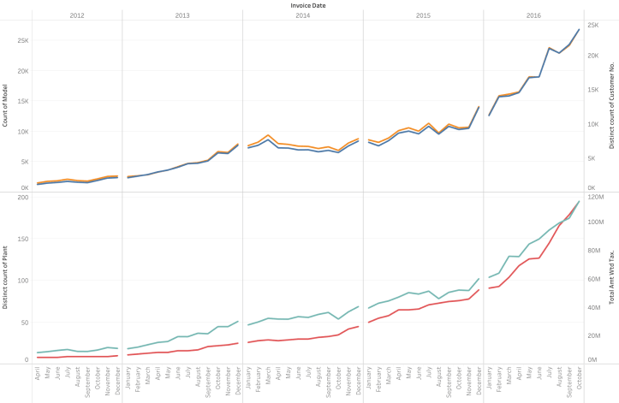
EDA: Growth Rate(Revenue, Cust. No., Plant No.)
Continue to increase vehicles & hence, customers for positive growth
Optimise plants
Optimise resources

Slide 19
EDA:%Growth change(Revenue, Cust. No., Plant No.)
Observations:
Revenue growth is linked with growth of vehicles and hence with growth in numbers of customers.
Revenue is not totally dependent on growth of number of plants, and depends on other features also.
Hence, more study was performed on other factors to target maximum growth.
Business is primarily driven by low segment vehicles, covering ~99.5% of the totally revenue

Slide 20
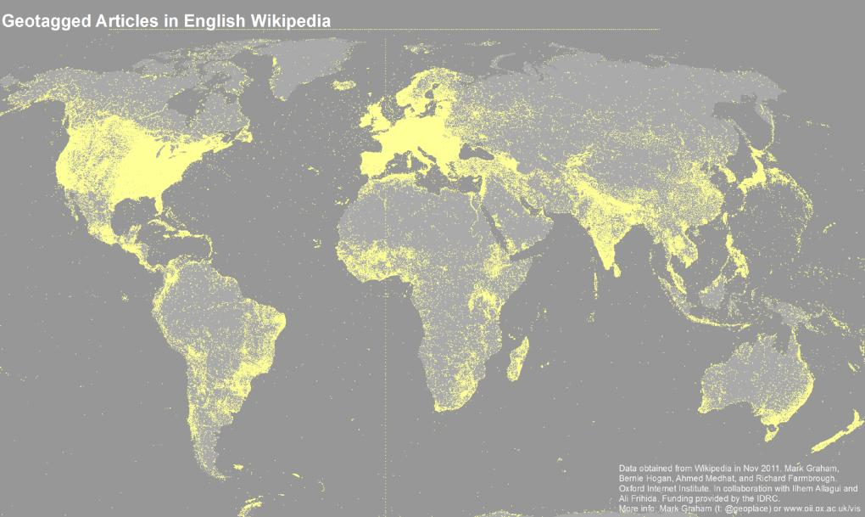
Geo-Location based analysis
Customer – Plant relationship
Client and Plant distribution
Revenue mapping (Customer base)

Slide 21
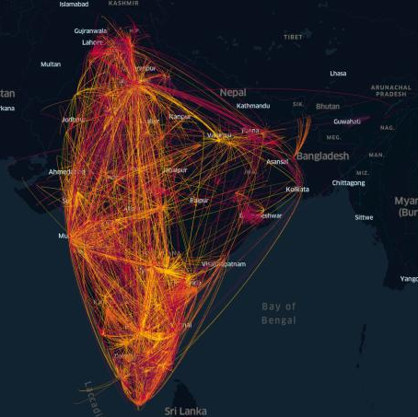
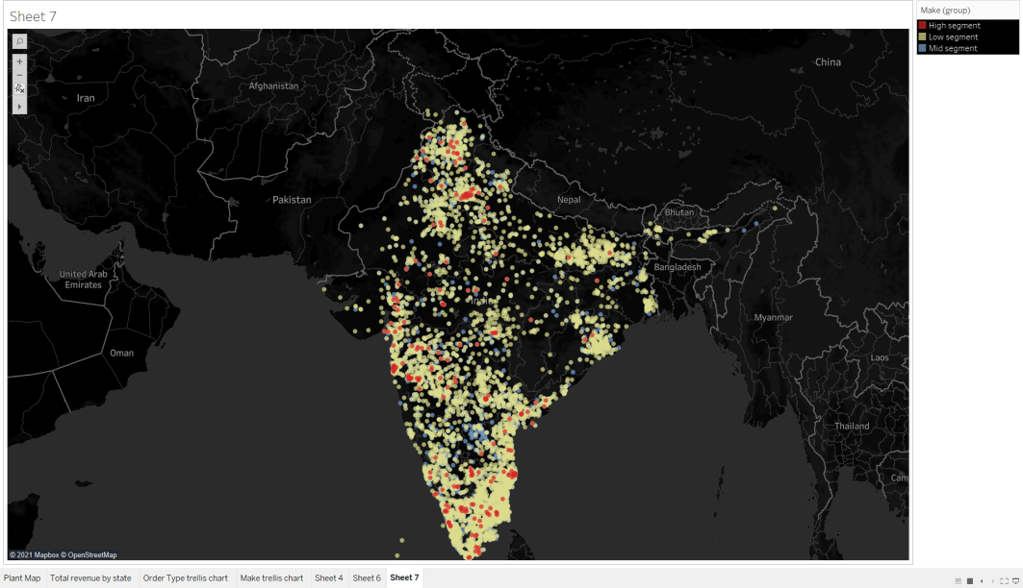
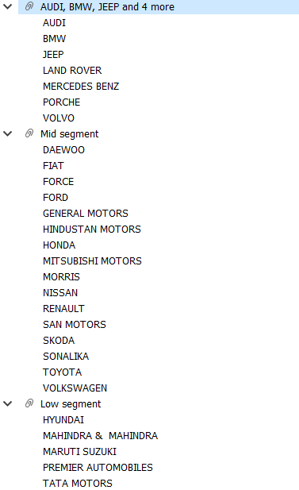
GEO-Plots (Customer-Plants relation)
Car Segmentation
Customer- Client network

Slide 22
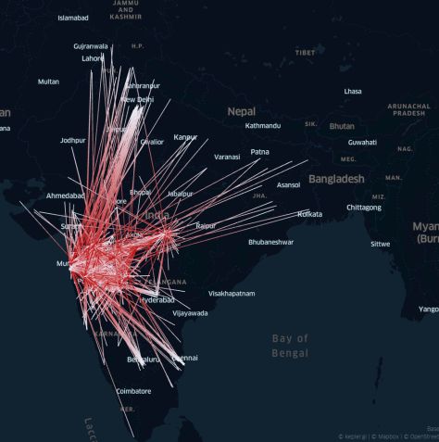
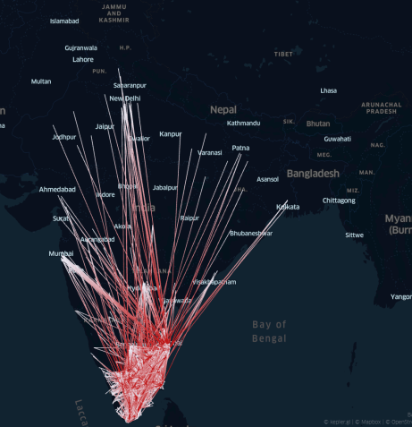
GEO-Plots (Customer-Plants relation)
Plant: Maharashtra
Plant: Tamilnadu

Slide 23
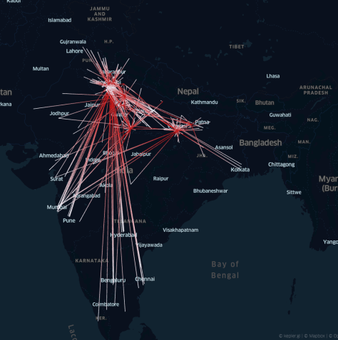
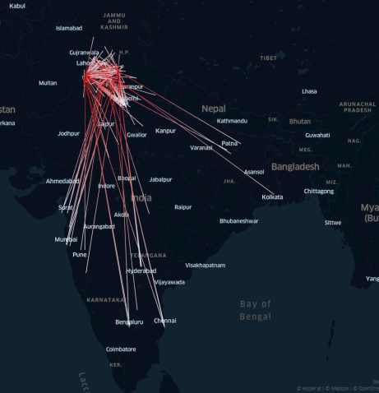
GEO-Plots (Customer-Plants relation)
Plant:
Uttar Pradesh
Plant: Punjab

Slide 24
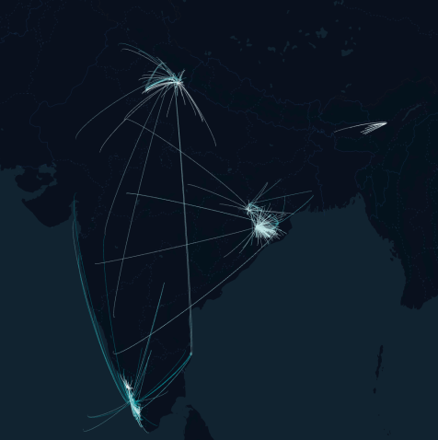
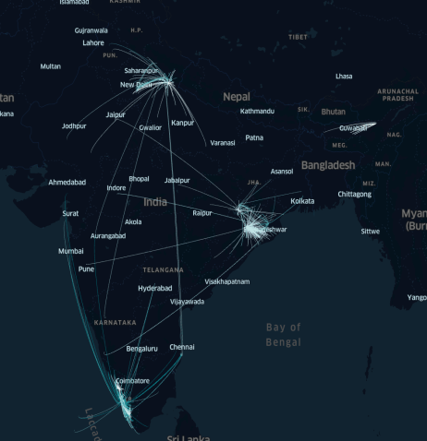
GEO-Plots (Customer-Plants relation)
Plant:
Kerela, Assam, Odissa, Uttarakhand

Slide 25
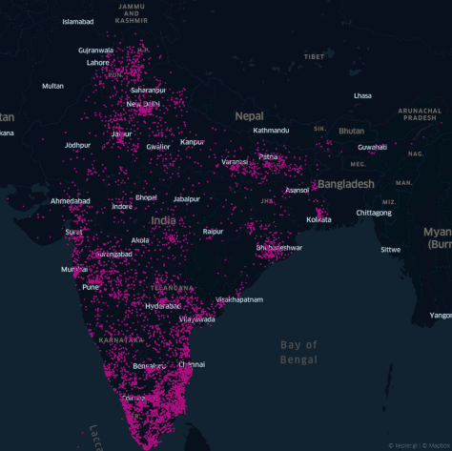
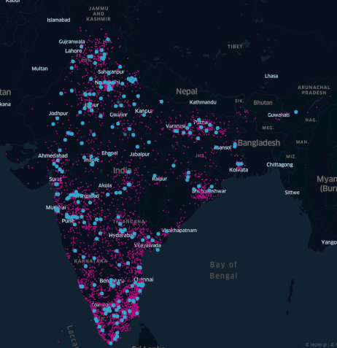
GEO-Plots (Customer-Plants relation)
Mapping of Customer Base
Mapping of Customer Base
With Plant

Slide 26
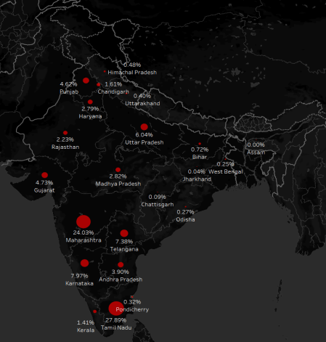
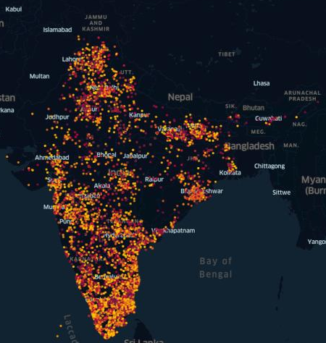
GEO-Plots (Customer-Plants relation)
Cash Inflow
State wise
Mapping of Client
(By Revenue)

Slide 27
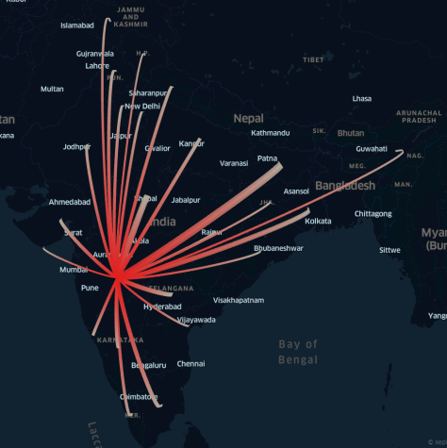
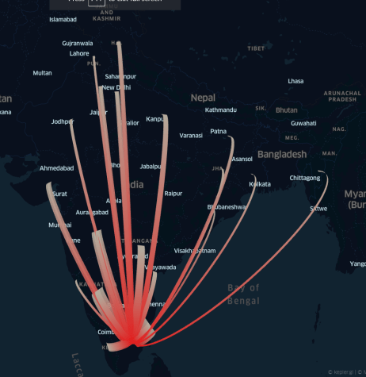
GEO-Plots (Customer-Plants relation)
Maharashtra Client base
(By Revenue)
Tamilnadu Client base
(By Revenue)

Slide 28

Why educate your Customer
Information
The data information gained from this can be used to improve future branding strategies or plan new ones.
Knowledge +Information
+ Product
Knowledge
The insights gained from this activity would help in understanding the impact of various marketing strategies deployed or product launches.
Product
Options for Passions, Trouble shooting and travel safety.

Slide 29

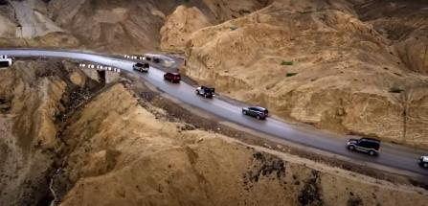
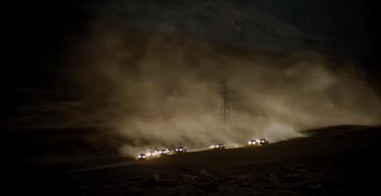
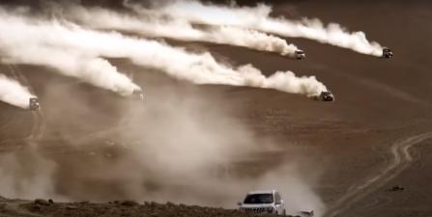
Knowledge + Information + Product
Travel cond’s: Harsh environments, breakdowns, support.

Slide 30

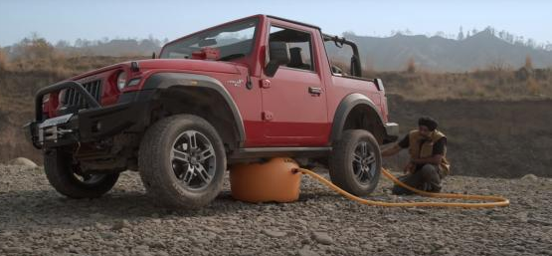
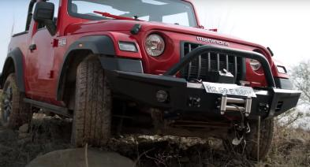



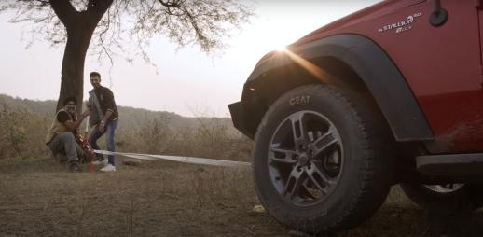
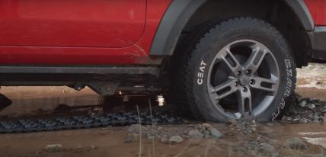

Knowledge + Information + Product

Slide 31





Knowledge + Information + Product
All CAR

Slide 32

Machine Learning
Clustering

Slide 33


ML:Clustering for client segmentation
Client segmentation was performed based on multiple parameters like customer region, type of order, sales organisation, etc. The optimum number of clusters were found to be 5.
We used PCA to reduce the number of dimensions to be able to visualise the clusters easily.

Slide 34

ML:Clustering for client segmentation
The above plot visualizes the clusters across all the parameters.

Slide 35
Observations & Recommendations
Revenue growth is linked with growth of vehicles and hence with growth in numbers of customers..
Business is primarily driven by low segment vehicles, covering ~99.5% of the totally revenue
Increasing Plants need not mandatorily address the business growth. Hence, number of plants can be optimised to increase the profit and QTQ revenue.

Slide 36
Future work:
More work needs to be done on data segregation and collection from other sources
A bit more of feature engineering could be performed to increase the model performance.
More work required to be done on ML segment in time series form to get accurate business forecasting.
CLTV needs to be derived.

Slide 37


